Slide 1
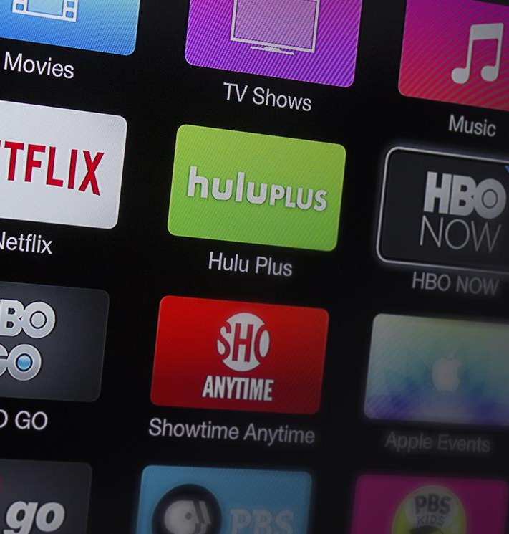
PROJECT 2: Customer Churn Prediction BERNADETTE DELUCA RYAN BRUNELLE LOUIS RAY

Slide 2
What is churn?
Customer churn represents users who discontinue a service or subscription.
High churn rates directly impact a company's revenue.
Identifying churn drivers can help reduce turnover and improve targeted customer retention retention strategies.

Slide 3

Objective
This project aims to predict customer churn by identifying patterns in user behavior, demographic, account age, and other relevant details enabling a company to better target those at risk of canceling a subscription or service.

Slide 4
Churn Data Overview
Data Collection: We used a database from kaggle that was already cleaned.
Data Pre-Processing: Checked for missing values, encoded non-numerical values, and scaled data before splitting train and test sets.
Model Selection: We decided to use Decision Tree, KNN, Logistic Regression, and Random Forest.
Model Evaluation: We analyzed the classification report and accuracy scores of all the selected models than plotted confusion matrices to visually understand the results.

Slide 5
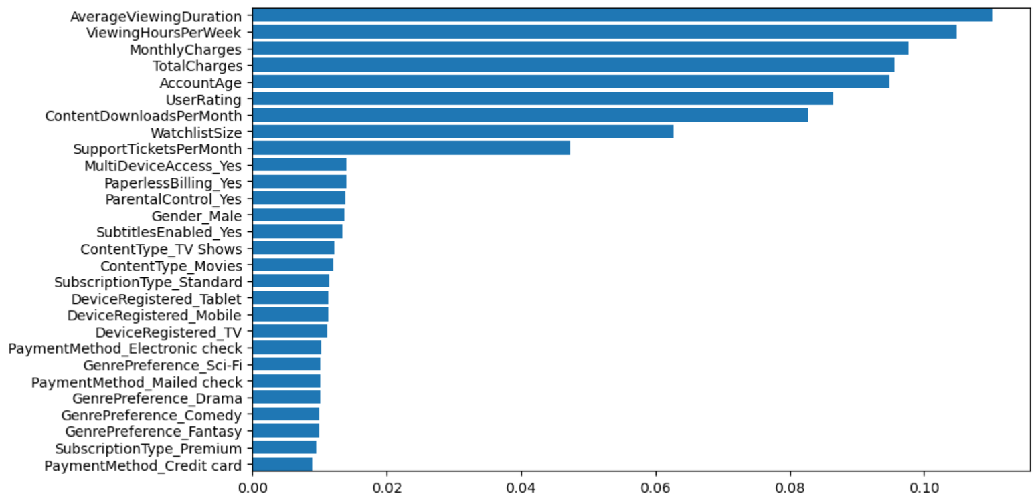
Dataframe Column Impact on Model
Columns
"""NOT DIRECT COEFFICIENT, BUT MERELY THE LEVEL OF IMPORTANCE OF COLUMN'S CORRELATION TO OUTCOME"""
Level of Importance

Slide 6
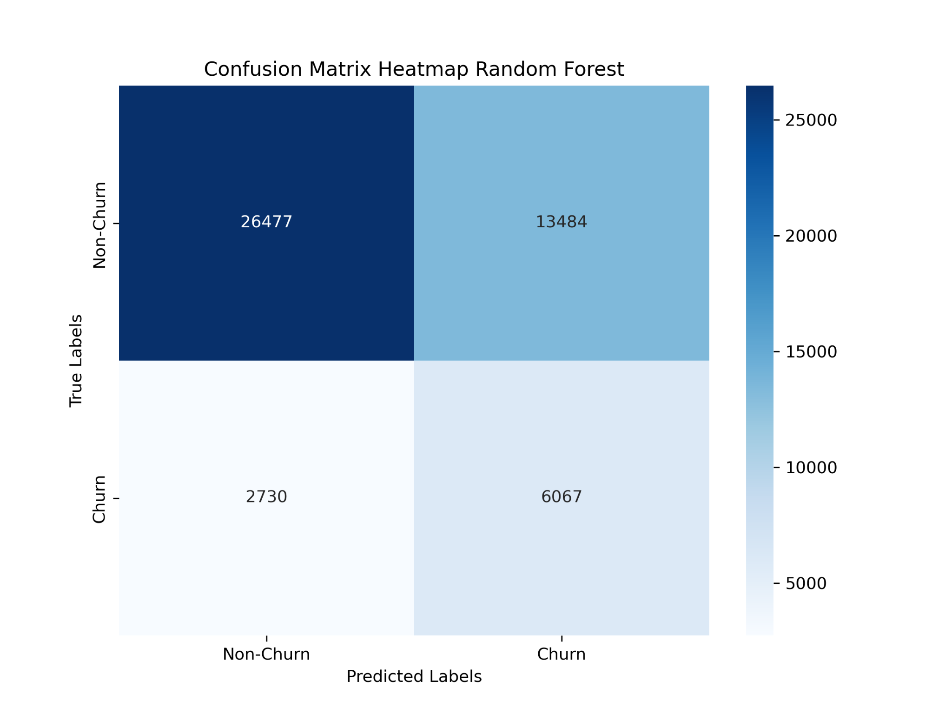
Random Forest Model
The model is accurate in identifying non-churn customers at 82%.
However, this model has limitations (56% recall) in accurately identifying churn cases.

Slide 7
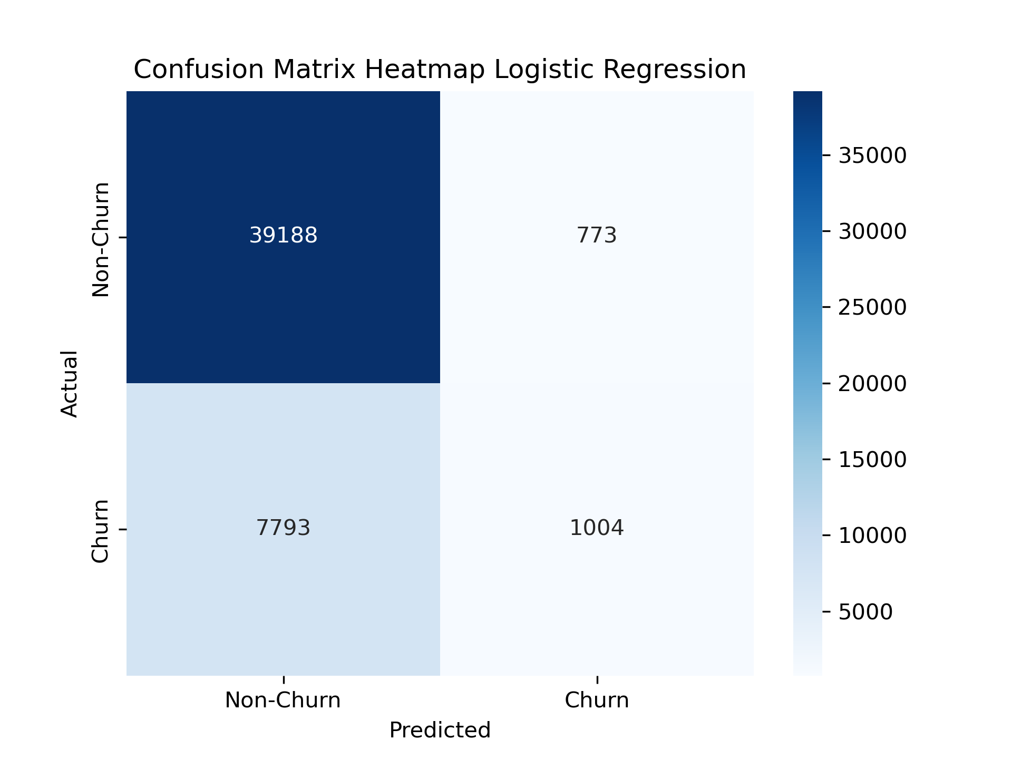
Logistic Regression Model
The model is accurate in identifying non-churn customers at 82% as well as the previous model.
However, this model has limitations (52% recall) in accurately identifying churn cases.

Slide 8
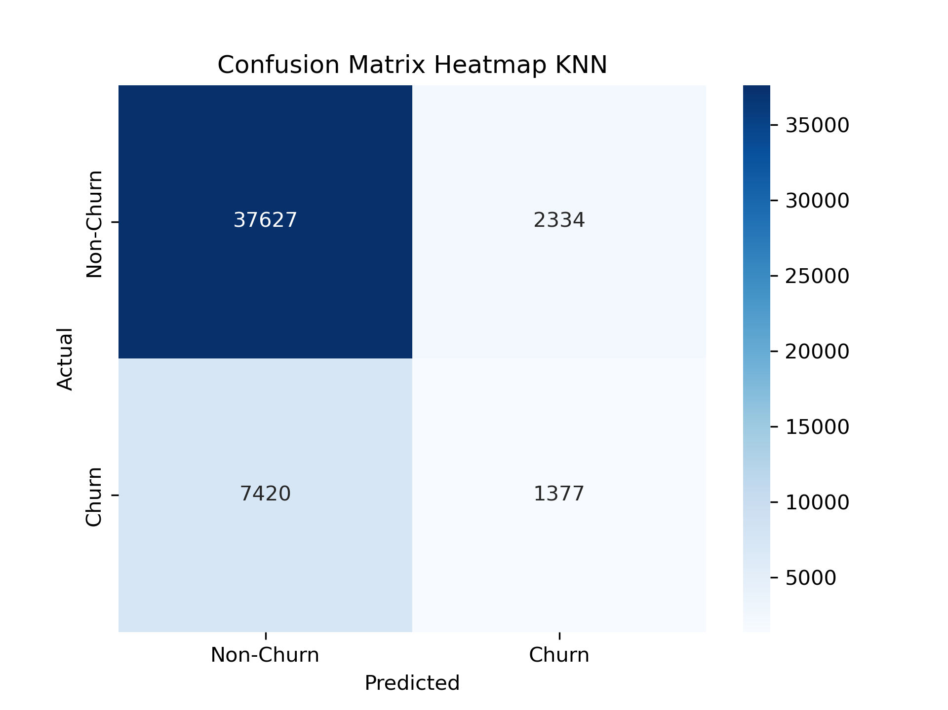
KNN Model
The model is accurate in identifying non-churn customers at 80%.
However, this model has limitations (37% recall) in accurately identifying churn cases.

Slide 9
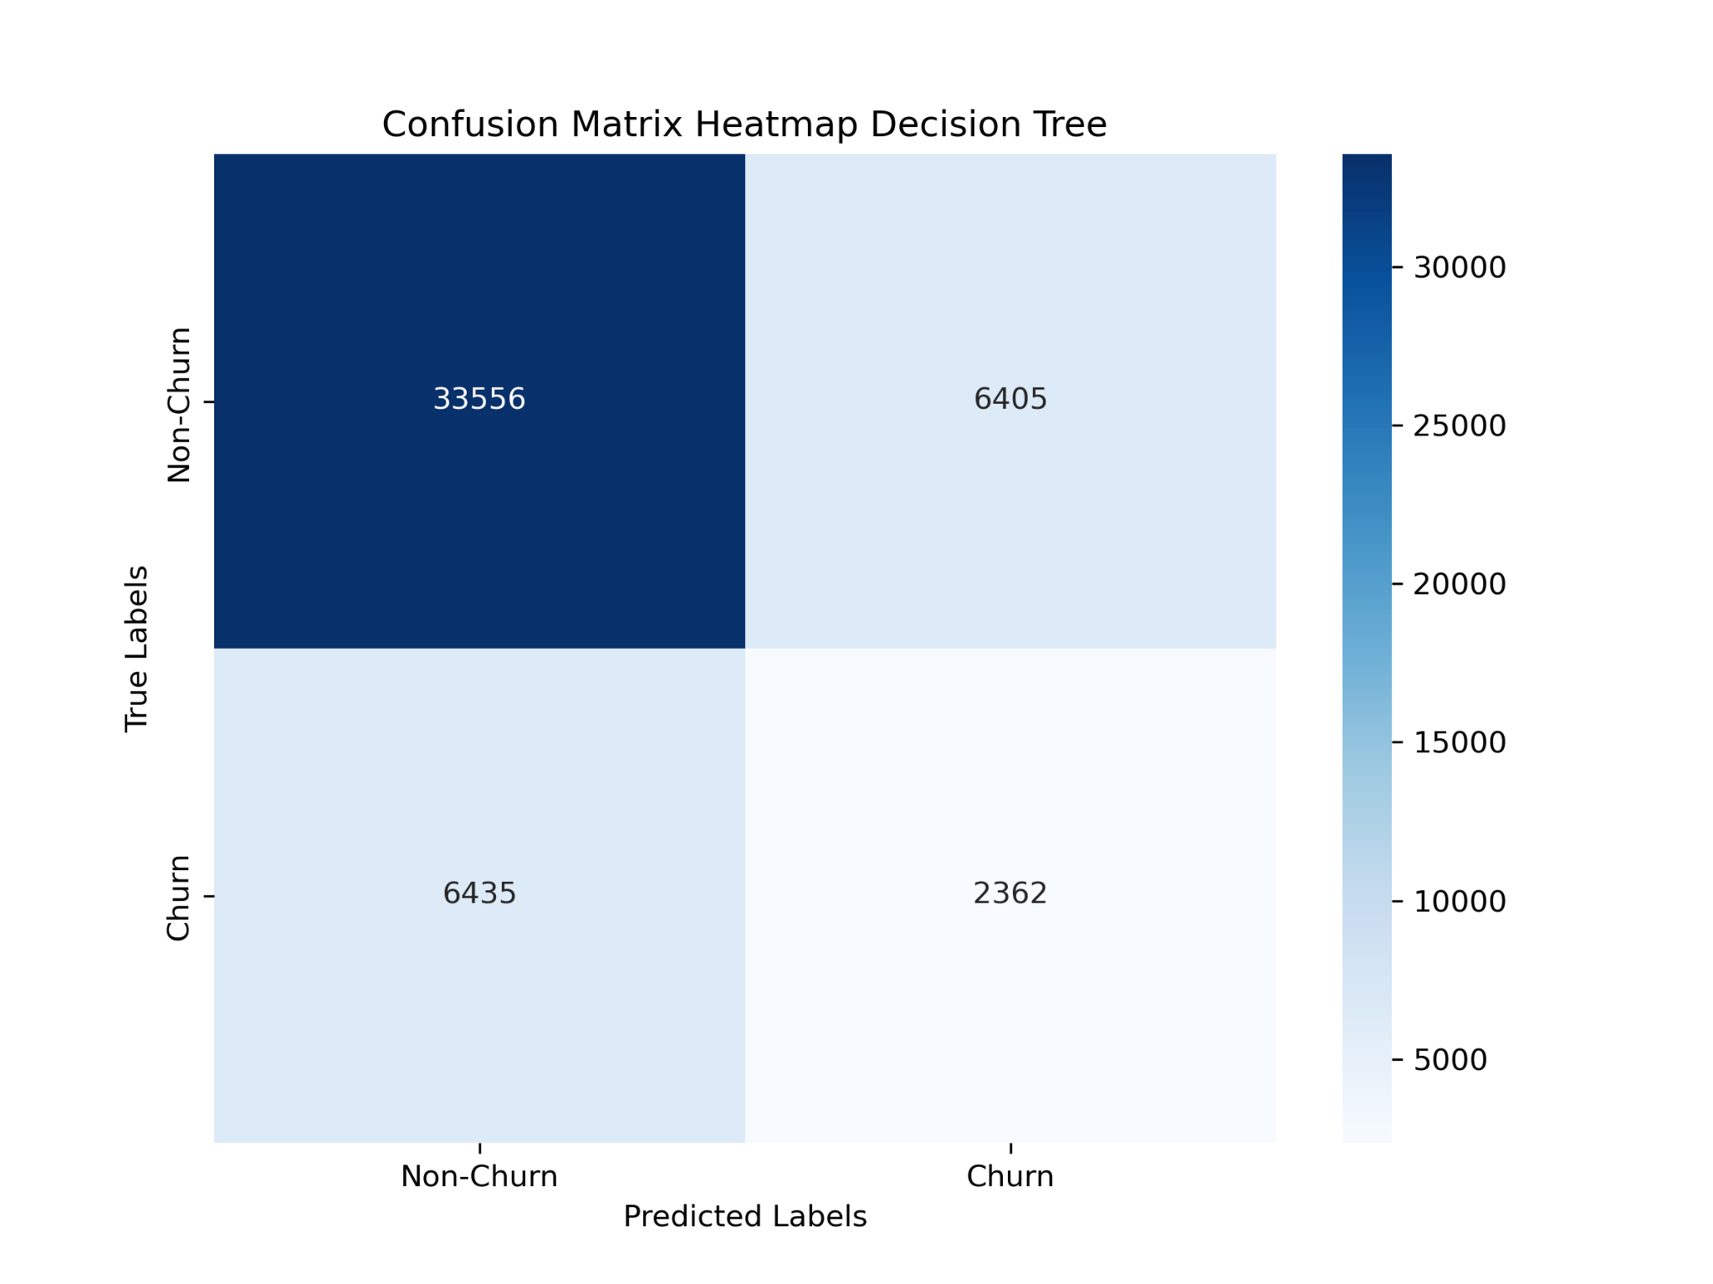
Decision Tree Model
The model is accurate in identifying non-churn customers at 74%.
However, this model has limitations (27% recall) in accurately identifying churn cases.

Slide 10
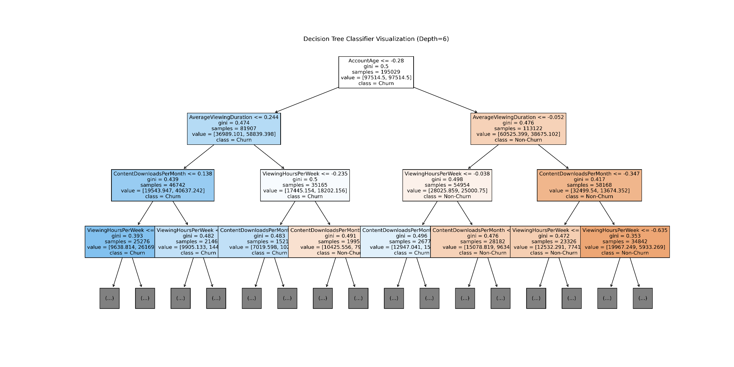
Notes:
Bottom left box - False Negatives

Slide 11
Findings
Model Performance: Across all models, we observed a strong performance in predicting non-churn cases but faced consistent challenges in accurately identifying churn cases.
Confusion Matrix: Confusion matrices across all models highlighted a common trend: a high number of false positives (non-churn incorrectly classed as churn) and false negatives (churn customers completely missed by the model). The high rate of false negatives reduces the effectiveness of the model for the goal of proactive retention.
Importance of Imbalance: Despite using methods like under-sampling and setting class weights to balanced, the imbalance between the churn and non churn classes remained a significant factor. All of the models tended to favor the majority class.

Slide 12
Conclusion
In conclusion, the analysis provides a solid foundation for churn prediction but highlights the inherent difficulty in accurately identifying churn cases in such an imbalanced dataset.
The current models are useful for understanding general patterns and trends in customer behavior, however, their practical use for targeted retention strategies is limited by their low recall for churn cases.

Slide 13
Teachable Moments
This project is further explaining the process of how to filter data that is either balanced or imbalanced. Also which classification model would fit best to demonstrate results for future products.
https://www.kaggle.com/datasets/safrin03/predictive-analytics-for-customer-churn-dataset/data
(Our data set)
https://semaphoreci.com/blog/imbalanced-data-machine-learning-python (We used various codes and read about imbalance data further on this website.)
https://www.geeksforgeeks.org (Resources for coding and giving image examples on how to use the code)
https://www.w3schools.com/ (Resources for coding and giving image examples on how to use the code)

Slide 14
Future Considerations
Collection of additional data (occupation, personal finance data, or other external factors)
Create essentially the opposite of a reward system in the models to penalize misclassification of churn cases more heavily, potentially improving recall for churn class.
Continue analysis using advanced practices like SMOTE, oversampling, and further undersampling to see if there is an effective solution to the imbalance issue without using synthetic data.

